Slide 1

Resource Concepts and Terms
resources: all materials in the environment that can be used.
reserves: quantities of resources that are known and are legally and economically extractable with current technology.
projected reserves: current reserves plus all resources that may become reserves due to improved technologies and changing prices.
renewable resources: such as farmland soil, water, solar, forests, and fisheries, where the sustainable rate of use can be no greater than the rate of regeneration.
solar-based renewable energy resources are ultimately powered by the sun: solar, wind, hydropower, wave and biomass

Slide 2

Resources (con’t.)
non-renewable resources: substances such as fossil fuels, high grade mineral ore, and fossil groundwater. Can these have a sustainable rate of use?
  one view: their sustainable rate of use can be no greater than the rate at which a renewable resource can be substituted for it (eg. oil, where part of the profits are invested towards the development of renewable resources, so that renewables can eventually substitute for oil)
  another view: libertarian…

Slide 3
Externalities: costs of an economic activity that are not directly paid for by the buyers and/or sellers of the activity
Energy externalities include:

Slide 4
The Human Command of Energy Through Time
In the distant human past, pre-fire and pre-agriculture, humans would have done all work with their own bodies. In such a setting, each human would need about 100 watts of power for sustenance. (2400 watt-hrs/day or 2.4 kWh)
But eventually, humans figured out how to accomplish more with their efforts:
  fire for cooking and hunting
  tools, domesticated animals, and agriculture
By 1800 the world average per person power utilization had quintupled to ~500 watts, (5 energy servants):
  water and wind power, some coal
By 2000, global average was 20 energy servants, in the US, 100+:
  combustion of fossil fuels (~87% from fossil fuels)
Are the global and US rates and sources sustainable?

Slide 5
Power and Energy
Power: rate of energy use through time (eg watts)
Energy: the capacity for doing work (but this def is too vague).
Some common forms of energy: heat (thermal energy), motion (kinetic or mechanical), light (electromagnetic), chemical (of fuels and foodstuffs).

Slide 6
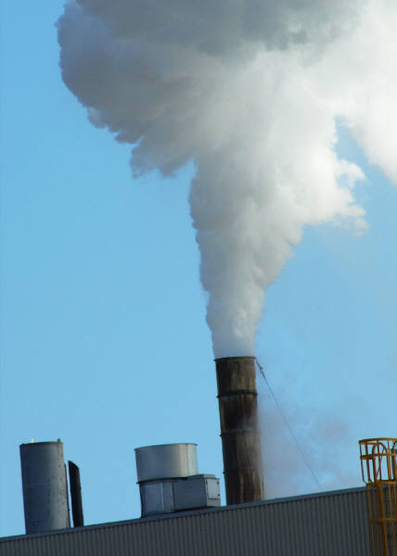
Resource concepts (con’t)
sustainable rate of emissions (pollutants): max. rate at which it can be recycled, absorbed, or rendered harmless by the environment.

